Slide 1
Network Security
Classical Encryption Techniques
Dr. Qaisar Javaid

Slide 2
Where we are …
Introduction to network security
Vulnerabilities in IP
I. CRYPTOGRAPHY
  Symmetric Encryption and Message Confidentiality
  Public-Key Cryptography and Message Authentication
II. NETWORK SECURITY APPLICATIONS
  Authentication Applications (Kerberos, X.509)
  Electronic Mail Security (PGP, S/MIME)
  IP Security (IPSec, AH, ESP, IKE)
  Web Security (SSL, TLS, SET)
  Network Management Security (SNMP)
III. SYSTEM SECURITY
  Intruders and intrusion detection
  Malicious Software (viruses)
  Firewalls and trusted systems
Network Security

Slide 3
Outline
Conventional Encryption Principles
Conventional Encryption Algorithms
  Caeser Cipher
  Monoalphabetic Cipher
  Polyalphabetic Cipher
    Vigenère Cipher
  Rotor Machines
  Steganography
Network Security

Slide 4
Classical Encryption
Techniques
Many savages at the present day regard their names as vital parts of themselves, and therefore take great pains to conceal their real names, lest these should give to evil-disposed persons a handle by which to injure their owners. —The Golden Bough, Sir James George Frazer
Network Security

Slide 5
Symmetric Encryption
Or conventional/private-key/single-key
Sender and recipient share a common key
All classical encryption algorithms are private-key
Was only type prior to invention of public-key in 1970’s
Network Security
Notes:
All traditional schemes are symmetric / single key / private-key encryption algorithms, with a single key, used for both encryption and decryption, since both sender and receiver are equivalent, either can encrypt or decrypt messages using that common key.

Slide 6
Basic Terminology
Plaintext - the original message
Ciphertext - the coded message
Cipher - algorithm for transforming plaintext to ciphertext
Key - info used in cipher known only to sender/receiver
Encipher (encrypt) - converting plaintext to ciphertext
Network Security
Notes:
Briefly review some terminology used throughout the course.

Slide 7
Basic Terminology
Decipher (decrypt) - recovering plaintext from ciphertext
Cryptography - study of encryption principles/methods
Cryptanalysis (codebreaking) - the study of principles/ methods of deciphering ciphertext without knowing key
Cryptology - the field of both cryptography and cryptanalysis
Network Security

Slide 8
Conventional Encryption Principles
An encryption scheme has five ingredients:
  Plaintext
  Encryption algorithm
  Secret Key
  Ciphertext
  Decryption algorithm
Security depends on the secrecy of the key, not the secrecy of the algorithm
Network Security

Slide 9

Symmetric Cipher Model
Network Security
Notes:
Detail 5 ingredients of the symmetric cipher model:
plaintext
encryption algorithm – performs substitutions/transformations on plaintext
secret key – control exact substitutions/transformations used in encryption algorithm
ciphertext
decryption algorithm – inverse of encryption algorithm

Slide 10
Requirements
Two requirements for secure use of symmetric encryption:
  a strong encryption algorithm
  a secret key known only to sender / receiver
Assumes encryption algorithm is known
Implies a secure channel to distribute key
  Y = E_{K}(X)
  X = D_{K}(Y)
Network Security
Notes:
Generally assume that the algorithm is known.
This allows easy distribution of s/w and h/w implementations.
Hence assume just keeping key secret is sufficient to secure encrypted messages.
Have plaintext X, ciphertext Y, key K, encryption alg Ek, decryption alg Dk.

Slide 11
Cryptography
Classified along three independent dimensions:
  type of encryption operations used for transforming plaintext to ciphertext
    substitution / transposition / product
  number of keys used
    symmetric - single-key or secret key encryption
    asymmetric - two-key or public key encryption
  way in which plaintext is processed
    block / stream
Network Security

Slide 12
Cryptanalysis
Two general approaches to attack an encryption scheme
  Cryptanalysis
    needs encryption algorithm plus some knowledge regarding the plaintext or some sample plaintext-ciphertext pair
  Brute-Force attack
    attacker tries every possible key to decrypt.
    needs to check so many keys
Network Security

Slide 13
Types of Cryptanalytic Attacks
Ciphertext only
  attacker only knows the encryption algorithm & ciphertext
Known plaintext
  knows the encryption algorithm & ciphertext
  additionally knows some sample plaintext-ciphertext pairs
Chosen plaintext
  attacker selects plaintext and obtains ciphertext to attack cipher
Network Security

Slide 14
Types of Cryptanalytic Attacks
Chosen ciphertext
  select ciphertext and obtain plaintext to attack cipher
Chosen text
  select either plaintext or ciphertext to en/decrypt to attack cipher
Network Security

Slide 15
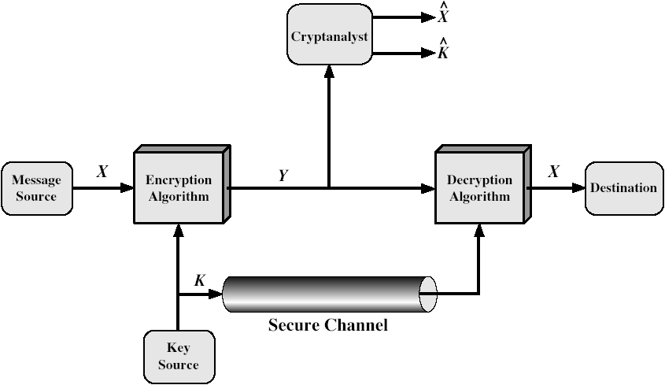
Model of Symmetric Cryptosystem
Network Security

Slide 16
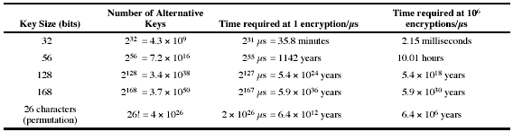
Brute Force Search
Always possible to simply try every key
Most basic attack, proportional to key size
Assume either know / recognise plaintext
Network Security

Slide 17
Average Time Required for Exhaustive Key Search
Key Size (bits) | Number of Alternative Keys | Time required at 10⁶ Decryption/µs
32 | 2³² = 4.3 x 10⁹ | 2.15 milliseconds
56 | 2⁵⁶ = 7.2 x 10¹⁶ | 10 hours
128 | 2¹²⁸ = 3.4 x 10³⁸ | 5.4 x 10¹⁸ years
168 | 2¹⁶⁸ = 3.7 x 10⁵⁰ | 5.9 x 10³⁰ years
Network Security

Slide 18
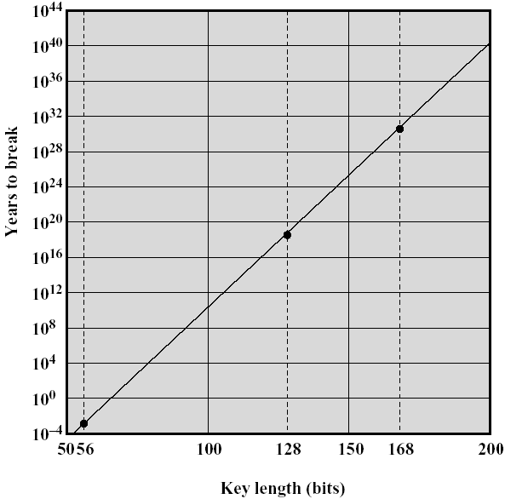
Time to Break a Code
(Assuming 10⁶ decryptions/µs)
Network Security

Slide 19
More Definitions
Unconditional security
  no matter how much computer power is available, the cipher cannot be broken since the ciphertext provides insufficient information to uniquely determine the corresponding plaintext
Computational security
  given limited computing resources (e.g. time needed for calculations is greater than age of universe), the cipher cannot be broken
Network Security
Notes:
Unconditional security would be nice, but the only known such cipher is the one-time pad (later). For all reasonable encryption algorithms, have to assume computational security where it either takes too long, or is too expensive, to bother breaking the cipher.

Slide 20
Classical Substitution Ciphers
Where letters of plaintext are replaced by other letters or by numbers or symbols
Or if plaintext is viewed as a sequence of bits, then substitution involves replacing plaintext bit patterns with ciphertext bit patterns
Network Security
Notes:
In this section and the next, we examine a sampling of what might be called classical encryption
techniques. A study of these techniques enables us to illustrate the basic approaches to
symmetric encryption used today and the types of cryptanalytic attacks that must be anticipated.
The two basic building blocks of all encryption techniques: substitution and transposition.
We examine these in the next two sections. Finally, we discuss a system that combine both
substitution and transposition.

Slide 21
Caesar Cipher
Earliest known substitution cipher
By Julius Caesar
First attested use in military affairs
Replaces each letter by 3rd letter of alphabets
Example:
  Plaintext: meet me after the toga party
  Ciphertext: PHHW PH DIWHU WKH WRJD SDUWB
Network Security
Notes:
Substitution ciphers form the first of the fundamental building blocks. The core idea is to replace one basic unit (letter/byte) with another. Whilst the early Greeks described several substitution ciphers, the first attested use in military affairs of one was by Julius Caesar, described by him in Gallic Wars (cf. Kahn pp83-84). Still call any cipher using a simple letter shift a caesar cipher, not just those with shift 3.
Note: when letters are involved, the following conventions are used in this course: Plaintext is always in lowercase; ciphertext is in uppercase; key values are in italicized lowercase.

Slide 22







Caesar Cipher
Can define transformation as:
Mathematically give each letter a number
  a b c d e f g h i j k l m
  0 1 2 3 4 5 6 7 8 9 10 11 12
  n o p q r s t u v w x y Z
  13 14 15 16 17 18 19 20 21 22 23 24 25
Network Security
Notes:
This mathematical description uses modulo arithmetic (ie clock arithmetic). Here, when you reach Z you go back to A and start again. Mod 26 implies that when you reach 26, you use 0 instead (ie the letter after Z, or 25 + 1 goes to A or 0).
Example: howdy (7,14,22,3,24) encrypted using key f (5) is MTBID

Slide 23
Caesar Cipher
Then we can generalize Caesar cipher as:
Where:
  p : letter to be converted into ciphertext
  k : offset e.g., 3 as in our example
  C : ciphertext
  C = E(p) = (p + k) mod (26)
  p = D(C) = (C – k) mod (26)
Network Security

Slide 24
Cryptanalysis of Caesar Cipher
Only have 26 possible ciphers
  A maps to A,B,..Z
Could simply try each in turn i.e., using a brute force search
Given ciphertext, just try all shifts of letters
Network Security
Notes:
With a caesar cipher, there are only 26 possible keys, of which only 25 are of any use, since mapping A to A etc doesn't really obscure the message! cf. basic rule of cryptanalysis "check to ensure the cipher operator hasn't goofed and sent a plaintext message by mistake"!
Can try each of the keys (shifts) in turn, until can recognise the original message. See Stallings Fig 2.3 for example of search.
Note: as mentioned before, do need to be able to recognise when have an original message (ie is it English or whatever). Usually easy for humans, hard for computers. Though if using say compressed data could be much harder.
Example "GCUA VQ DTGCM" when broken gives "easy to break", with a shift of 2 (key C).

Slide 25
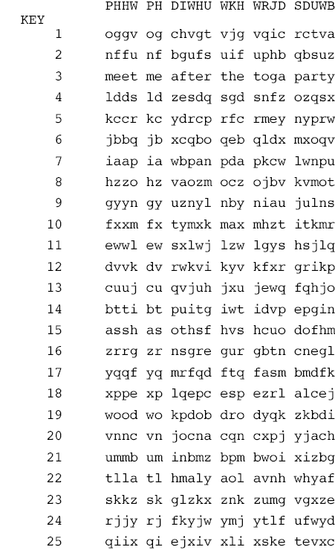
Brute-Force Cryptanalysis of Caesar Cipher
Network Security

Slide 26
Cryptanalysis of Caesar Cipher
Do need to recognize when have plaintext
eg. break ciphertext “KHOOR ZRUOG“
H E L L O W O R L D
-3
K H O O R Z R U O G
Network Security
Notes:
With a caesar cipher, there are only 26 possible keys, of which only 25 are of any use, since mapping A to A etc doesn't really obscure the message! cf. basic rule of cryptanalysis "check to ensure the cipher operator hasn't goofed and sent a plaintext message by mistake"!
Can try each of the keys (shifts) in turn, until can recognise the original message. See Stallings Fig 2.3 for example of search.
Note: as mentioned before, do need to be able to recognise when have an original message (ie is it English or whatever). Usually easy for humans, hard for computers. Though if using say compressed data could be much harder.
Example "GCUA VQ DTGCM" when broken gives "easy to break", with a shift of 2 (key C).

Slide 27
Compressed Plaintext
The input may be abbreviated or compressed
Encrypted using simple substitution, decrypting is not simple as plaintext is not understandable
Network Security

Slide 28
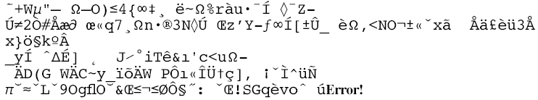
Sample of Compressed Text
Network Security

Slide 29
Monoalphabetic Cipher
Rather than just shifting the alphabet
Could shuffle (jumble) the letters arbitrarily
Each plaintext letter maps to a different random ciphertext letter
Hence key is 26 letters long
Network Security

Slide 30
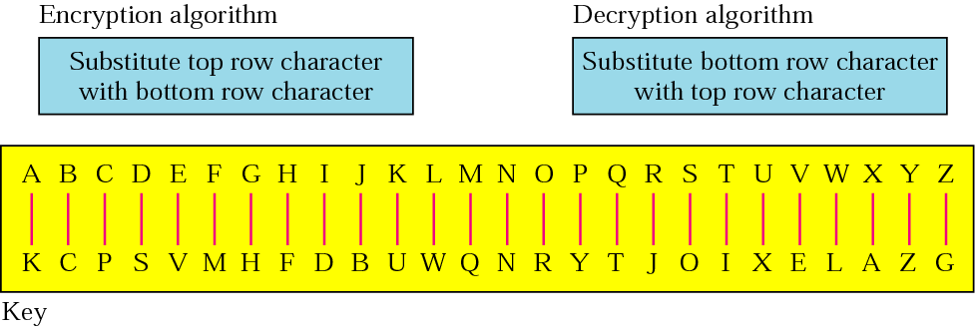
Monoalphabetic Cipher
Key is 26 letters long
Network Security

Slide 31
Monoalphabetic Cipher Example
  Plaintext: ifwewishtoreplaceletters
  Ciphertext: DMLVLDOFIRJVYWKPVWVIIVJO
Network Security

Slide 32
Monoalphabetic Cipher Security
Now have a total of 26! = 4 x 10²⁶ keys
With so many keys, might think it is secure
But would be !!!WRONG!!!
Problem is language characteristics
Network Security

Slide 33
Language Redundancy and Cryptanalysis
Human languages are redundant
e.g. ciphertext
  Plaintext
Can see the redundancy in the ciphertext
  it can be exploited
Letters are not equally commonly used
" DMLVLDOFIRJVYWKPVWVIIVJO "
“ifwewishtoreplaceletters”
Network Security
Notes:
As the example shows, we don't actually need all the letters in order to understand written English text. Here vowels were removed, but they're not the only redundancy. cf written Hebrew has no vowels for same reason. Are usually familiar with "party conversations", can hear one person speaking out of hubbub of many, again because of redundancy in aural language also. This redundancy is also the reason we can compress text files, the computer can derive a more compact encoding without losing any information. Basic idea is to count the relative frequencies of letters, and note the resulting pattern.

Slide 34
Language Redundancy and Cryptanalysis
In English e is by far the most common letter
Then T,R,N,I,O,A,S
Other letters are fairly rare; like Z,J,K,Q,X
Have tables of single, double & triple letter frequencies
Network Security

Slide 35

English Letter Frequencies
Network Security
Notes:
This graph is based on counts done at ADFA in the late 1980's, and used to develop the tables published in Seberry & Pieprzyk [SEBE89].
Note that all human languages have varying letter frequencies, though the number of letters and their frequencies varies.
Seberry & Pieprzyk [SEBE89] Appendix A has graphs for 20 languages (most European & Japanese & Malay).

Slide 36
Use in Cryptanalysis
Key concept - monoalphabetic substitution ciphers do not change relative letter frequencies
Discovered by Arabian scientists in 9th century
Calculate letter frequencies for ciphertext
Compare counts/plots against known values
Network Security
Notes:
The simplicity and strength of the monoalphabetic substitution cipher meant it dominated cryptographic use for the first millenium AD. It was broken by Arabic scientists. The earliest known description is in Abu al-Kindi's "A Manuscript on Deciphering Cryptographic Messages", published in the 9th century but only rediscovered in 1987 in Istanbul, but other later works also attest to their knowledge of the field.

Slide 37
Use in Cryptanalysis
If Caesar cipher look for common peaks/troughs
  peaks at: A-E-I triple, NO pair, RST triple
  troughs at: JK, X-Z
For monoalphabetic must identify each letter
  tables of common double/triple letters help
Network Security

Slide 38
Cryptanalysis Example
Given ciphertext:
Count relative letter frequencies (see text)
Guess P & Z are ‘e’ and ‘t’
Guess ZW is ‘th’ and hence ZWP is ‘the’
Proceeding with trial and error finally get:
  UZQSOVUOHXMOPVGPOZPEVSGZWSZOPFPESXUDBMETSXAIZ
  VUEPHZHMDZSHZOWSFPAPPDTSVPQUZWYMXUZUHSX
  EPYEPOPDZSZUFPOMBZWPFUPZHMDJUDTMOHMQ
  it was disclosed yesterday that several informal but
  direct contacts have been made with political
  representatives of the viet cong in moscow
Network Security

Slide 39
Playfair Cipher
Not even the large number of keys in a monoalphabetic cipher provides security
One approach to improving security was to encrypt multiple letters
The Playfair Cipher is an example
Invented by Charles Wheatstone in 1854, but named after his friend Baron Playfair
Network Security
Notes:
Consider ways to reduce the "spikyness" of natural language text, since if just map one letter always to another, the frequency distribution is just shuffled. One approach is to encrypt more than one letter at once. Playfair cipher is an example of doing this.

Slide 40
Playfair Key Matrix
A 5X5 matrix of letters based on a keyword
Fill in letters of keyword (sans duplicates)
Fill rest of matrix with other letters
e.g., using the keyword MONARCHY
    M O N A R
    C H Y B D
    E F G I/J K
    L P Q S T
    U V W X Z
Network Security
Notes:
Have here the rules for filling in the 5x5 matrix, L to R, top to bottom, first with keyword after duplicate letters have been removed, and then with the remain letters, with I/J used as a single letter. This example comes from Dorothy Sayer's book "Have His Carcase", in which Lord Peter Wimsey solves this, and describes the use of a probably word attack.

Slide 41
Playfair
Encrypting and Decrypting
Plaintext encrypted two letters at a time:
  If a pair is a repeated letter, insert a filler like 'X', e.g., "balloon" encrypts as "ba lx lo on"
  If both letters fall in same row,
  replace each with letter to right
  (wrapping back to start from end)
  e.g., “ar" encrypts as "RM"
M O N A R
C H Y B D
E F G I K
L P Q S T
U V W X Z
Network Security
Notes:
Note the various rules, and how you wrap from right side back to left, or from bottom back to top. Decrypting of course works exactly in reverse. Can see this by working the example pairs shown, backwards.

Slide 42
Playfair
Encrypting and Decrypting
  If both letters fall in the same column, replace each with the letter below it (again wrapping to top from bottom), e.g., “mu" encrypts to "CM"
  Otherwise each letter replaced
  by the one in its row in the column
  of the other letter of the pair,
  e.g., “hs" encrypts to "BP", and “ea"
  to "IM" or "JM" (as desired)
M O N A R
C H Y B D
E F G I K
L P Q S T
U V W X Z
Network Security

Slide 43
Security of the Playfair Cipher
Security much improved over monoalphabetic
Since have 26 x 26 = 676 digrams
Would need a 676 entry frequency table to analyse (verses 26 for a monoalphabetic)
And correspondingly more ciphertext
Network Security

Slide 44
Security of the Playfair Cipher
Was widely used for many years (eg. US & British military in WW1)
It can be broken, given a few hundred letters
Since still has much of plaintext structure
Network Security

Slide 45
Polyalphabetic Ciphers
Another approach to improving security is to use multiple cipher alphabets
Makes cryptanalysis harder with more alphabets to guess and flatter frequency distribution
Use a key to select which alphabet is used for each letter of the message
Use each alphabet in turn
Repeat from start after end of key is reached
Network Security
Notes:
One approach to reducing the "spikyness" of natural language text is used the Playfair cipher which encrypts more than one letter at once. We now consider the other alternative, using multiple cipher alphabets in turn. This gives the attacker more work, since many alphabets need to be guessed, and because the frequency distribution is more complex, since the same plaintext letter could be replaced by several ciphertext letters, depending on which alphabet is used.

Slide 46
Vigenère Cipher
Simplest polyalphabetic substitution cipher is the Vigenère Cipher
Effectively multiple Caesar ciphers
Key is multiple letters long K = k₁ k₂ ... k_{d}
i^{th} letter specifies i^{th} alphabet to use
Network Security
Notes:
Simply create a set of caesar cipher translation alphabets, then use each in turn, as shown next.

Slide 47
Vigenère Cipher
Use each alphabet in turn
Repeat from start after d letters in message
Decryption simply works in reverse
Network Security

Slide 48
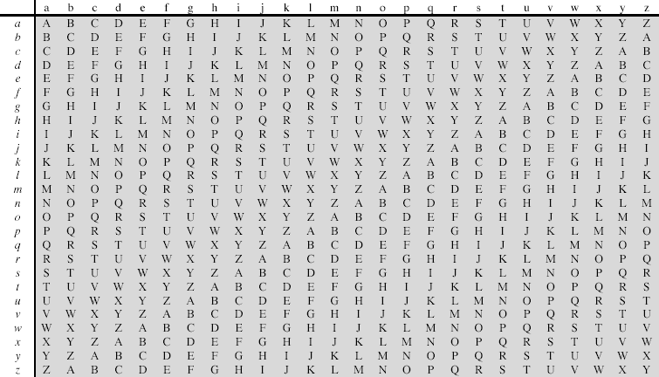
Modern Vigenère Tableau
Network Security

Slide 49
Example
Write the plaintext out
Write the keyword repeated above it
Use each key letter as a Caesar cipher key
Encrypt the corresponding plaintext letter
e.g. using keyword deceptive
  key: deceptivedeceptivedeceptive
  plaintext: wearediscoveredsaveyourself
  ciphertext:ZICVTWQNGRZGVTWAVZHCQYGLMGJ
  key: deceptivedeceptivedeceptive
  plaintext: wearediscoveredsaveyourself
  ciphertext: ZICVTWQNGRZGVTWAVZHCQYGLMGJ
Network Security

Slide 50
Aids
Simple aids can assist with en/decryption
A Saint-Cyr Slide is a simple manual aid
  a slide with repeated alphabet
  line up plaintext 'A' with key letter, e.g. 'C'
  then read off any mapping for key letter
Can bend round into a cipher disk
Or expand into a Vigenère Tableau (see Table 2.3)
Network Security

Slide 51
Security of Vigenère Ciphers
Have multiple ciphertext letters for each plaintext letter
Hence letter frequencies are obscured
But not totally lost
Start with letter frequencies
  see if look monoalphabetic or not
If not, then need to determine number of alphabets, since then can attach each
Network Security

Slide 52
Kasiski Method
Method developed by Babbage / Kasiski
Repetitions in ciphertext give clues to period
So find same plaintext an exact period apart
Which results in the same ciphertext
Of course, could also be random fluke
Network Security
Notes:
For some centuries the Vigenère cipher was le chiffre indéchiffrable (the unbreakable cipher). As a result of a challenge, it was broken by Charles Babbage (the inventor of the computer) in 1854 but kept secret (possibly because of the Crimean War - not the first time governments have kept advances to themselves!). The method was independently reinvented by a Prussian - Friedrich Kasiski who published the attack now named after him in 1863. However lack of major advances meant that various polyalphabetic substitution ciphers were used into the 20C. One very famous incident was the breaking of the Zimmermann telegram in WW1 which resulted in the USA entering the war.
In general the approach is to find a number of duplicated sequences, collect all their distances apart, look for common factors, remembering that some will be random flukes and need to be discarded. Now have a series of monoalphabetic ciphers, each with original language letter frequency characteristics. Can attack these in turn to break the cipher.

Slide 53
Kasiski Method
e.g. repeated “VTW” in previous example
Suggests size of 3 or 9
Then attack each monoalphabetic cipher individually using same techniques as before
Network Security
Notes:
For some centuries the Vigenère cipher was le chiffre indéchiffrable (the unbreakable cipher). As a result of a challenge, it was broken by Charles Babbage (the inventor of the computer) in 1854 but kept secret (possibly because of the Crimean War - not the first time governments have kept advances to themselves!). The method was independently reinvented by a Prussian - Friedrich Kasiski who published the attack now named after him in 1863. However lack of major advances meant that various polyalphabetic substitution ciphers were used into the 20C. One very famous incident was the breaking of the Zimmermann telegram in WW1 which resulted in the USA entering the war.
In general the approach is to find a number of duplicated sequences, collect all their distances apart, look for common factors, remembering that some will be random flukes and need to be discarded. Now have a series of monoalphabetic ciphers, each with original language letter frequency characteristics. Can attack these in turn to break the cipher.

Slide 54
Autokey Cipher
Ideally want a key as long as the message
Vigenère proposed the autokey cipher, where keyword is prefixed to message as key
Knowing keyword can recover the first few letters
Use these in turn on the rest of the message but still have frequency characteristics to attack
Network Security
Notes:
See that the key used is the keyword "DECEPTIVE" prefixed to as much of the message "WEAREDISCOVEREDSAV" as is needed. When deciphering, recover the first 9 letters using the keyword "DECEPTIVE". Then instead of repeating the keyword, start using the recovered letters from the message "WEAREDISC". As recover more letters, have more of key to recover later letters.
Problem is that the same language characteristics are used by the key as the message. ie. a key of 'E' will be used more often than a 'T' etc
hence an 'E' encrypted with a key of 'E' occurs with probability (0.1275)2 = 0.01663, about twice as often as a 'T' encrypted with a key of 'T'
have to use a larger frequency table, but it exists given sufficient ciphertext this can be broken.

Slide 55
Autokey Cipher Example
e.g., given key deceptive
  key: deceptivedeceptivedeceptive
  plaintext: wearediscoveredsaveyourself
  ciphertext:ZICVTWQNGKZEIIGASXSTSLVVWLA
Network Security

Slide 56
One-Time Pad
If a truly random key as long as the message is used, the cipher will be secure
called a One-Time pad
Is unbreakable since ciphertext bears no statistical relationship to the plaintext
Since for any plaintext & any ciphertext there exists a key mapping one to other
Can only use the key once
It has problem of safe distribution of key
Network Security
Notes:
The One-Time Pad is an evolution of the Vernham cipher, which was invented by Gilbert Vernham in 1918, and used a long tape of random letters to encrypt the message. An Army Signal Corp officer, Joseph Mauborgne, proposed an improvement using a random key that was truly as long as the message, with no repetitions, which thus totally obscures the original message.
Since any plaintext can be mapped to any ciphertext given some key, there is simply no way to determine which plaintext corresponds to a specific instance of ciphertext.

Slide 57
One-Time Pad Example I
  ciphertext:
  ANKYODKYUREPFJBYOJDSPLREYIUNOFDOIUERFPLUYTS
key:
pxlmvmsydoftyrvzwc tnlebnecvgdupahfzzlmnyih
plaintext:
mr mustard with the candlestick in the hall
Network Security

Slide 58
One-Time Pad Example II
Same ciphertext produces two different outputs with two different keys
  ciphertext:
  ANKYODKYUREPFJBYOJDSPLREYIUNOFDOIUERFPLUYTS
key:
mfugpmiydgaxgoufhklllmhsqdqogtewbqfgyovuhwt
plaintext:
miss scarlet with the knife in the library
Network Security

Slide 59
Transposition Ciphers
Now consider classical transposition or permutation ciphers
These hide the message by rearranging the letter order without altering the actual letters used
The cryptanalyst can recognise the cipher easily since it has the same letter frequency as the original text
Network Security
Notes:
Transposition Ciphers form the second basic building block of ciphers. The core idea is to rearrange the order of basic units (letters/bytes/bits) without altering their actual values.

Slide 60
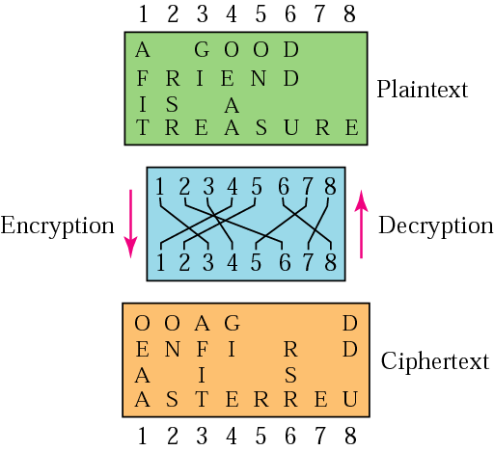
Transpositional Cipher
Example
Network Security

Slide 61
Rail Fence Cipher
Write message letters diagonally over a number of rows
Then read off cipher row by row
e.g., write message out as:
Giving ciphertext
  m e m a t r h t g p r y
  e t e f e t e o a a t
  MEMATRHTGPRYETEFETEOAAT
Network Security
Notes:
Example message is: "meet me after the toga party" with a rail fence of depth 2.

Slide 62
Row Transposition Ciphers
A more complex scheme
Write letters of message out in rows over a specified number of columns
Then reorder the columns according to some key before reading off the rows
  Key: 4 3 1 2 5 6 7
  Plaintext: a t t a c k p
  o s t p o n e
  d u n t i l t
  w o a m x y z
  Ciphertext: TTNAAPTMTSUOAODWCOIXKNLYPETZ
Network Security

Slide 63
Product Ciphers
Ciphers using substitutions or transpositions are not secure because of language characteristics
Hence consider using several ciphers in succession to make harder, but:
  Two substitutions make a more complex substitution
  Two transpositions make more complex transposition
  But a substitution followed by a transposition makes a new much harder cipher
Network Security

Slide 64
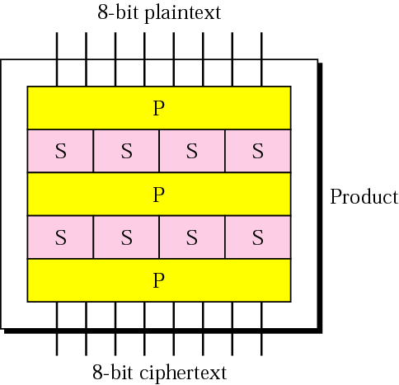
Product Ciphers
This is bridge from classical to modern ciphers
P-Permutation Box
S-Substitution Box
Network Security

Slide 65
Rotor Machines
Before modern ciphers, rotor machines were most common product cipher
These were widely used in WW2
  German Enigma, Allied Hagelin, Japanese Purple
Implemented as a very complex, varying substitution cipher
Network Security

Slide 66
Rotor Machines
Rotor Machines
  used a series of cylinders
  each giving one substitution
  rotated and changed after each letter was encrypted
Each machine with 3 cylinders have 26³=17576 alphabets
Network Security

Slide 67
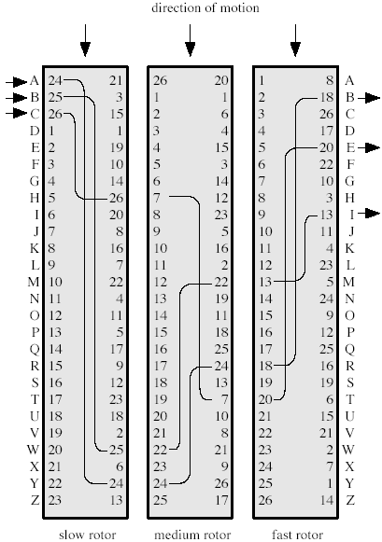
Three-Rotor Machine
Initial setting
Network Security

Slide 68
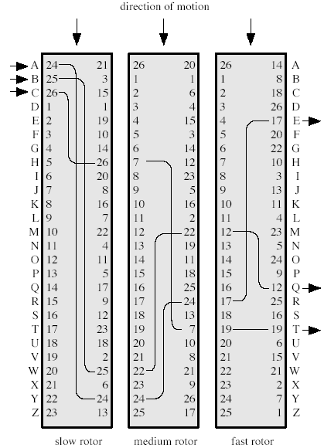
Three-Rotor Machine
Setting after one keystroke
Network Security

Slide 69
Three-Rotor Machine
Network Security

Slide 70
Steganography
An alternative to encryption
Hides existence of message
  Using only a subset of letters/words in a longer message marked in some way
  Using invisible ink
  Hiding in LSB in graphic image or sound file
Has drawbacks
  High overhead to hide relatively few info bits
Network Security

Slide 71
Summary
Have considered:
  Classical cipher techniques and terminology
  Monoalphabetic substitution ciphers
  Cryptanalysis using letter frequencies
  Playfair ciphers
  Polyalphabetic ciphers
  Transposition ciphers
  Product ciphers and rotor machines
  Steganography
Network Security

